Slide 1
Overview of “INITERIM EVALUATION REPORT” on NR RIT (3GPP)
Takaharu Nakamura
Leader of 5GMF IMT-2020 Evaluation Group, 5GMF (Fujitsu)
Workshop on IMT-2020 terrestrial radio interfaces evaluation
Geneva, Switzerland, 10-11 December 2019

Slide 2
Contents
IMT-2020 Evaluation Group of 5GMF
Overview of “INITERIM EVALUATION REPORT” on NR RIT (3GPP)

Slide 3
IMT-2020 Evaluation Group of 5GMF
1

Slide 4
5GMF (Organizational structure and membership)
5GMF(The Fifth Generation Mobile Communications Promotion Forum)
Established : September 2014 (taking over ARIB 2020 and Beyond Ad Hoc.)
Objectives : Innovative R&D through Industry-Academia-Government cooperation.
International Standardization and Collaboration.
Collaboration with 5G Field Trials.
Members : 164 (Special:3, Individual:18, Ordinary:135, Local community: 8 as of Nov. 2019)
General Assembly
Secretariat
ARIB,TTC
5G Trial
Promotion Group
Advisory Board
Strategy
& Planning
Committee
Technical
Committee
Service &
Application
Committee
Network
Architecture
Committee
Community Use Promotion Committee
Security Study Committee
Organizational Structure of 5GMF

Slide 5
Structure of 5GMF with IMT-2020 Evaluation Group
General Assembly
5G Trial Promotion Group
Strategy &
Planning
Committee
Technical
Committee
Network
Architecture
Committee
Service & Application Committee
IMT-2020 Evaluation Group
Community Use promotion Committee
Security Study Committee

Slide 6
5GMF IMT-2020 Evaluation Group members
Ericsson Japan | Nihon Dengyo Kosaku
FUJITSU | Nokia Solutions and Networks Japan
Huawei Japan | NTT
KDDI | NTT docomo
Kyoto University | Sharp
Mitsubishi Electric | Sophia University
NEC | ZTE Japan

Slide 7
Collaboration with related entities
ITU-R SG5 WP5D
Ministry of Internal Affairs and Communications, Japan
The Information and Communications Council
ITU-R Sub-Council
Entities in Japan
(Study/Evaluate IMT-2020 SRIT/RIT)
Association of Radio Industries and Businesses(ARIB)
Advanced Wireless Communications Study Committee (ADWICS)
Standardization Subcommittee
5GMF Technical committee IMT-2020 Evaluation Group
Collaboration

Slide 8
Overall schedule for the development of IMT-2020 radio interface Recommendation (WP5D)
Ref: IMT-2020/2 "SUBMISSION, EVALUATION PROCESS AND CONSENSUS BUILDING FOR IMT-2020,” ITU-R WP5D
Equivalent info.: http://www.itu.int/en/ITU-R/study-groups/rsg5/rwp5d/imt-2020/Documents/IMT-2020_Schedule.docx

Slide 9
Overview of “INITERIM EVALUATION REPORT”
2

Slide 10
Part I: Administrative aspects of the Independent Evaluation Group
Name of the Independent Evaluation Group
IMT-2020 Evaluation Group, The Fifth Generation Mobile Communications Promotion Forum (5GMF IEG)
Method of Work
The evaluation method in this report is in line with what are suggested in ITU-R report M.2412 that are inspection, analysis and simulation. Regarding simulation works, all of the contributors to this evaluation report participated 3GPP meetings and submitted their simulation results there and provided the same results to the report. As the consequence the simulation outcomes in this report include and re-use part of the self-evaluation report from 3GPP.

Slide 11
Part II: Technical aspects of the work of the Independent Evaluation Group (up to ‘verification’)
Evaluated candidate technologies for IMT-2020
NR RIT in ITU-R IMT.2020 CONTRIBUTION 3 (REV. 3) (“3GPP” UNDER STEP 3 OF THE IMT-2020 PROCESS)
Utilization of ITU-R evaluation guidelines
The evaluations were performed in accord with in Report ITU R M.2412-0
Documentation of any additional evaluation methodologies
None
Verification as per Report ITU-R M.2411 of the compliance templates
Nothing special (not identified so far)

Slide 12
Assessment in the interim report (Services & Frequency range)
5.2.4.1.1 Support for wide range of services
Is the proposal able to support a range of services across different usage scenarios (eMBB, URLLC, and mMTC)?: ☑YES / NO
As provided in chapter 6 in the interim report.
5.2.4.2.1 Frequency bands identified for IMT
Is the proposal able to utilize at least one frequency band identified for IMT in the ITU Radio Regulations?: ☑ YES /  NO
5.2.4.2.2 Higher Frequency range/band(s)
Is the proposal able to utilize the higher frequency range/band(s) above 24.25 GHz?: ☑YES /  NO

Slide 13
Frequency bands of NR RIT (FR1) [1/3]
NR operating band | Uplink (UL) operating band BS receive / UE transmit F_{UL_low} – F_{UL_high} | Downlink (DL) operating band BS transmit / UE receive F_{DL_low} – F_{DL_high} | Duplex Mode | IMT related articles (notes) in Radio Regulations*
n71 | 663 MHz – 698 MHz | 617 MHz – 652 MHz | FDD | 460-890 MHz: 5.295 (470-608 MHz, or portions thereof) 5.296A (470-698 MHz, or portions thereof, and 610-698 MHz, or portions thereof) 5.308A (614-698 MHz) 5.313A (698-790 MHz) 5.317A (698-960 MHz in Region 2, 694-790 MHz in Region 1 and 790-960 MHz in Regions 1 and 3)
n12 | 699 MHz – 716 MHz | 729 MHz – 746 MHz | FDD
n28 | 703 MHz – 748 MHz | 758 MHz – 803 MHz | FDD
n83 | 703 MHz – 748 MHz | N/A | SUL
n20 | 832 MHz – 862 MHz | 791 MHz – 821 MHz | FDD
n5 | 824 MHz – 849 MHz | 869 MHz – 894 MHz | FDD
n82 | 832 MHz – 862 MHz | N/A | SUL
n8 | 880 MHz – 915 MHz | 925 MHz – 960 MHz | FDD
n81 | 880 MHz – 915 MHz | N/A | SUL

Slide 14
Frequency bands of NR RIT (FR1) [2/3]
NR operating band | Uplink (UL) operating band BS receive / UE transmit F_{UL_low} – F_{UL_high} | Downlink (DL) operating band BS transmit / UE receive F_{DL_low} – F_{DL_high} | Duplex Mode | IMT related articles (notes) in Radio Regulations*
n51 | 1427 MHz – 1432 MHz | 1427 MHz – 1432 MHz | TDD | 1 300-1 525 MHz: 5.341A (1 427-1 452 MHz and 1 492-1 518 MHz in Region 1) 5.341B (1 427-1 518 MHz in Region 2) 5.341C (1 427-1 452 MHz and 1 492-1 518 MHz in Region 3 5.346 (1 452-1 492 MHz) 5.346A (1 452-1 492 MHz)
n74 | 1427 MHz – 1470 MHz | 1475 MHz – 1518 MHz | FDD
n76 | N/A | 1427 MHz – 1432 MHz | SDL
n50 | 1432 MHz – 1517 MHz | 1432 MHz – 1517 MHz | TDD
n75 | N/A | 1432 MHz – 1517 MHz | SDL
n70 | 1695 MHz – 1710 MHz | 1995 MHz – 2020 MHz | FDD | 1 710-2 170 MHz: 5.384A (1 710-1 885 MHz, 2 300-2 400 MHz and 2 500-2 690 MHz) 5.388 (1 885-2 025 MHz and 2 110-2 200 MHz) 5.388A (1 885-1 980 MHz, 2 010-2 025 MHz and 2 110-2 170 MHz in Regions 1 and 3 and, 1 885-1 980 MHz and 2 110-2 160 MHz in Region 2)
n3 | 1710 MHz – 1785 MHz | 1805 MHz – 1880 MHz | FDD
n66 | 1710 MHz – 1780 MHz | 2110 MHz – 2200 MHz | FDD
n80 | 1710 MHz – 1785 MHz | N/A | SUL
n86 | 1710 MHz – 1780 MHz | N/A | SUL
n2 | 1850 MHz – 1910 MHz | 1930 MHz – 1990 MHz | FDD
n25 | 1850 MHz – 1915 MHz | 1930 MHz – 1995 MHz | FDD
n39 | 1880 MHz – 1920 MHz | 1880 MHz – 1920 MHz | TDD
n1 | 1920 MHz – 1980 MHz | 2110 MHz – 2170 MHz | FDD
n84 | 1920 MHz – 1980 MHz | N/A | SUL
n34 | 2010 MHz – 2025 MHz | 2010 MHz – 2025 MHz | TDD

Slide 15
Frequency bands of NR RIT (FR1) [3/3]
NR operating band | Uplink (UL) operating band BS receive / UE transmit F_{UL_low} – F_{UL_high} | Downlink (DL) operating band BS transmit / UE receive F_{DL_low} – F_{DL_high} | Duplex Mode | IMT related articles (notes) in Radio Regulations*
n40 | 2300 MHz – 2400 MHz | 2300 MHz – 2400 MHz | TDD
n41 | 2496 MHz – 2690 MHz | 2496 MHz – 2690 MHz | TDD
n7 | 2500 MHz – 2570 MHz | 2620 MHz – 2690 MHz | FDD
n38 | 2570 MHz – 2620 MHz | 2570 MHz – 2620 MHz | TDD
n77 | 3300 MHz – 4200 MHz | 3300 MHz – 4200 MHz | TDD | 2 700-3 600 MHz: 5.429B (3 300-3 400 MHz), 5.429D (3 300-3 400 MHz), 5.429F (3 300-3 400 MHz), 5.430A (3 400-3 600 MHz), 5.431B (3 400-3 600 MHz), 5.432A (3 400-3 500 MHz), 5.432B (3 400-3 500 MHz), 5.433A (3 500-3 600 MHz) 3 600-4 800 MHz: 5.434 (3 600-3 700 MHz) 4 800-5 250 MHz: 5.441A (4 800-4 900 MHz) 5.441B (4 800-4 990 MHz)
n78 | 3300 MHz – 3800 MHz | 3300 MHz – 3800 MHz | TDD
n79 | 4400 MHz – 5000 MHz | 4400 MHz – 5000 MHz | TDD

Slide 16
Frequency bands of NR RIT (FR2)
NR operating band | Uplink (UL) and Downlink (DL) operating band BS transmit/receive UE transmit/receive F_{UL_low} – F_{UL_high} F_{DL_low} – F_{DL_high} | Duplex Mode
n257 | 26500 MHz – 29500 MHz | TDD
n258 | 24250 MHz – 27500 MHz | TDD
n260 | 37000 MHz – 40000 MHz | TDD
n261 | 27500 MHz – 28350 MHz | TDD

Slide 17
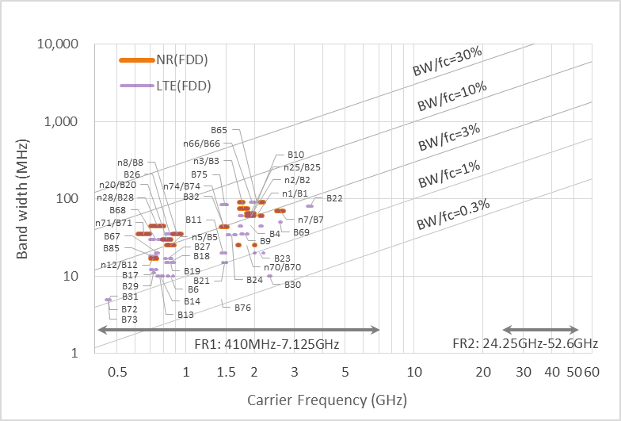
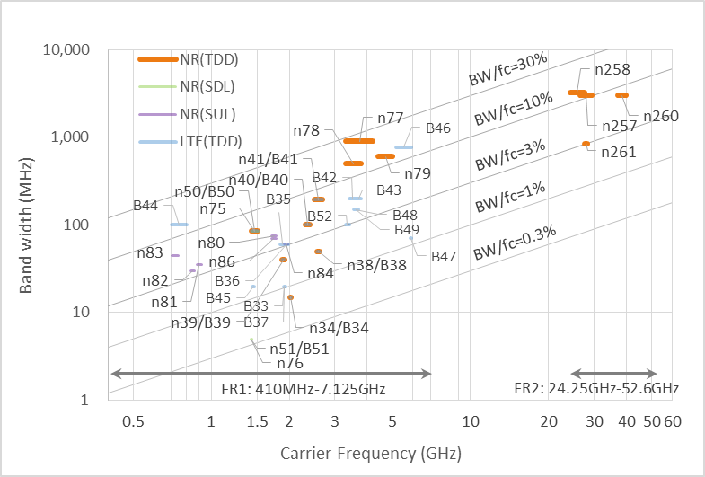
Carrier frequency vs. bandwidth specified for NR (and LTE)
Ref: 3GPP TS 36.101, "E-UTRA; User Equipment (UE) radio transmission and reception" (V.15.7.0) 2019-06 3GPP TS 38.101-1, "NR; User Equipment (UE) radio transmission and reception; Part 1: Range 1 Standalone" (V.15.6.0) 2019-06 3GPP TS 38.101-2, "NR; User Equipment (UE) radio transmission and reception; Part 2: Range 2 Standalone" (V.15.6.0) 2018-06

Slide 18
Peak spectral efficiency (DL)
Table A-2.1-1 NR FDD DL peak spectral efficiency (bit/s/Hz) [Overhead:OH₄]
SCS「kHz] |  | 5 MHz | 10 MHz | 15 MHz | 20 MHz | 25 MHz | 30 MHz | 40 MHz | 50 MHz | 60 MHz | 80 MHz | 90 MHz | 100 MHz
FR1 | 15 | 49.2 | 51.5 | 52.2 | 52.6 | 52.8 | 53.0 | 53.7 | 53.7 | - | - | - | -
 | 30 | 42.7 | 47.2 | 50.1 | 50.5 | 51.5 | 51.6 | 52.6 | 52.8 | 53.7 | 53.9 | 54.1 | 54.3
 | 60 | - | 42.7 | 47.0 | 47.2 | 48.9 | 50.1 | 50.5 | 51.5 | 52.2 | 53.1 | 53.4 | 53.6
Table A-2.1-2 NR TDD DL peak spectral efficiency (bit/s/Hz) [DSUUD, 6DL:2GP:6UL, Overhead:OH₄]
SCS「kHz] |  | 5 MHz | 10 MHz | 15 MHz | 20 MHz | 25 MHz | 30 MHz | 40 MHz | 50 MHz | 60 MHz | 80 MHz | 90 MHz | 100 MHz
FR1 | 15 | 49.3 | 51.5 | 52.3 | 52.6 | 52.9 | 53.0 | 53.7 | 53.7 | - | - | - | -
 | 30 | 42.8 | 47.3 | 50.1 | 50.5 | 51.6 | 51.6 | 52.6 | 52.9 | 53.7 | 53.9 | 54.1 | 54.3
 | 60 | - | 42.8 | 47.1 | 47.3 | 49.0 | 50.1 | 50.5 | 51.6 | 52.3 | 53.1 | 53.4 | 53.7
Table A-2.1-3 NR TDD DL peak spectral efficiency (bit/s/Hz) [DSUUD, 6DL:2GP:6UL, Overhead:OH₄]
SCS「kHz] |  | 50 MHz | 100 MHz | 200 MHz | 400 MHz
FR2 | 60 | 52.1 | 52.3 | 52.4 | -
 | 120 | 50.1 | 52.1 | 52.3 | 52.4

Slide 19
Peak spectral efficiency (UL)
Table A-2.2.1 NR FDD UL peak spectral efficiency (bit/s/Hz) [Overhead:OH₄]
SCS「kHz] |  | 5 MHz | 10 MHz | 15 MHz | 20 MHz | 25 MHz | 30 MHz | 40 MHz | 50 MHz | 60 MHz | 80 MHz | 90 MHz | 100 MHz
FR1 | 15 | 24.6 | 25.7 | 26.1 | 26.3 | 26.4 | 26.5 | 26.8 | 26.8 | - | - | - | -
 | 30 | 21.3 | 23.6 | 25.0 | 25.2 | 25.8 | 25.8 | 26.3 | 26.4 | 26.8 | 27.0 | 27.1 | 27.1
 | 60 | - | 21.3 | 23.5 | 23.6 | 24.5 | 25.0 | 25.2 | 25.8 | 26.1 | 26.6 | 26.7 | 26.8
Table A-2.2-2 NR TDD UL peak spectral efficiency (bit/s/Hz) [DSUUD, 6DL:2GP:6UL, Overhead:OH₄]]
SCS「kHz] |  | 5 MHz | 10 MHz | 15 MHz | 20 MHz | 25 MHz | 30 MHz | 40 MHz | 50 MHz | 60 MHz | 80 MHz | 90 MHz | 100 MHz
FR1 | 15 | 24.6 | 25.7 | 26.1 | 26.3 | 26.4 | 26.5 | 26.8 | 26.8 | - | - | - | -
 | 30 | 21.3 | 23.6 | 25.0 | 25.2 | 25.8 | 25.8 | 26.3 | 26.4 | 26.8 | 27.0 | 27.1 | 27.1
 | 60 | - | 21.3 | 23.5 | 23.6 | 24.5 | 25.0 | 25.2 | 25.8 | 26.1 | 26.6 | 26.7 | 26.8
Table A-2.2-3 NR TDD UL peak spectral efficiency (bit/s/Hz) [DSUUD, 6DL:2GP:6UL, Overhead:OH₄]
SCS「kHz] |  | 50 MHz | 100 MHz | 200 MHz | 400 MHz
FR2 | 60 | 26.2 | 26.2 | 26.3 | -
 | 120 | 25.3 | 26.2 | 26.2 | 26.3

Slide 20
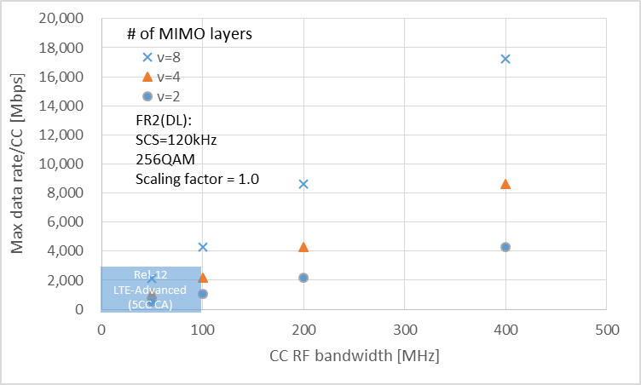
Peak data rate (per component carrier)
×
Source: 3GPP TS 38.306, “NR; User Equipment (UE) radio access capabilities, (V 15.6.0-June. 2019
.

Slide 21
Compliance template for technical performance [1/2]
Minimum technical performance requirements item (5.2.4.3.x), units, and Report ITU-R M.2410-0 section reference(1) | Required value | Value⁽²⁾ | Requirement met?
5.2.4.3.1 Peak data rate (Gbit/s) -4.1 | 20 | [37.0~74.8] | ☑ Yes No
 | 10 | 16.6~64.6 | ☑ Yes No
5.2.4.3.2 Peak spectral efficiency (bit/s/Hz) -4.2 | 30 | [42.8~54.3] | ☑ Yes No
 | 15 | [18.5~37.4] | ☑ Yes No
5.2.4.3.3 User experienced data rate (Mbit/s) -4.3 | 100 | [103.74~105.75] | ☑ Yes No
 | 50 | [50.87~57.45] | ☑ Yes No
5.2.4.3.4 5th percentile user spectral efficiency (bit/s/Hz) | 0.3 | [0.34~0.56] | ☑ Yes No
 | 0.21 | [0.23~0.40] | ☑ Yes No
 | 0.225 | [0.24~0.63] | ☑ Yes No
 | 0.15 | [0.16-0.45] | ☑ Yes No
 | 0.12 | [0.24-0.53] | ☑ Yes No
 | 0.045 | [0.09-0.15] | ☑ Yes No
 | 0.12 | [0.25-0.64] | ☑ Yes No
 | 0.045 | [0.16-0.45] | ☑ Yes No
5.2.4.3.5 Average spectral efficiency (bit/s/Hz/ TRxP) -4.5 | 9 | [12~16.88] | ☑ Yes No
 | 6.75 | [6.08~10.19] | ☑ Yes No
 | 7.8 | [5.0~9.21 | ☑ Yes No
 | 5.4 | [6.1~10.5] | ☑ Yes No
 | 3.3 | 7.87~22.33 | ☑ Yes No
 |  | [11.1~21.1] | ☑ Yes No
 | 1.6 | [4.2~6.3] | ☑ Yes No
 |  | [3.1~10.3] | ☑ Yes No
5.2.4.3.6 Area traffic capacity (Mbit/s/m²) -4.6 | 10 | [t.b.c.] | ☐ Yes No
5.2.4.3.7 User plane latency (ms) (4.7.1) | 4 | [t.b.c.] | ☐ Yes No
 | 1 | [t.b.c.] | ☐ Yes No
5.2.4.3.8 Control plane latency (ms) (4.7.2) | 20 | [t.b.c.] | ☐ Yes No
 | 20 | [t.b.c.] | ☐ Yes No
5.2.4.3.9 Connection density (devices/km²) -4.8 | 1 000 000 | [32,432,810.5/ 180 kHz~ | ☑ Yes No
 |  | 33,320,641.5/ 180 kHz]
 |  | [1,203,883.5 / 180 kHz~ | ☑ Yes No

Slide 22
Compliance template for technical performance [2/2]
5.2.4.3.10 Energy efficiency -4.9 | Capability to support a high sleep ratio and long sleep duration |  | ☑ Yes No
5.2.4.3.11 Reliability -4.1 | 1-10⁻⁵ success probability of transmitting a layer 2 PDU (protocol data unit) of size 32 bytes within 1 ms in channel quality of coverage edge | [99.9998310%~ | ☑ Yes No
 |  | 99.9999999%]
 |  | [99.9999950%~ | ☑ Yes No
 |  | 99.9999997%]
 |  | [99.9998987%~ | ☑ Yes No
 |  | 99.9999990%]
 |  | [99.9995354%~ | ☑ Yes No
 |  | 99.9999991%]
5.2.4.3.12 Mobility classes -4.11 | Stationary, Pedestrian | Stationary, Pedestrian | ☑ Yes No
 | Stationary, Pedestrian, Vehicular (up to 30 km/h) | Stationary, Pedestrian, Vehicular (up to 30 km/h) | ☑ Yes No
 | Pedestrian, Vehicular, High speed vehicular | Pedestrian, Vehicular, High speed vehicular | ☑ Yes No
5.2.4.3.13 Mobility Traffic channel link data rates (bit/s/Hz) -4.11 | 1.5 (10 km/h) | [1.59~2.07] | ☑ Yes No
 |  | [2.84~2.84] | ☑ Yes No
 | 1.12 (30 km/h) | [1.79~2.22] | ☑ Yes No
 |  | [1.24~1.24] | ☑ Yes No
 | 0.8 (120 km/h) | [2.06~2.91 | ☑ Yes No
 | 0.45 (500 km/h) | [1.62~2.64] | ☑ Yes No
 | 0.8 (120 km/h) | [1.16~1.741 | ☑ Yes No
 | 0.45 (500 km/h) | [0.83~1.33] | ☑ Yes No
5.2.4.3.14 Mobility interruption time (ms) -4.12 | 0 | 0 | ☑ Yes No
5.2.4.3.15 Bandwidth and Scalability -4.13 | At least 100 MHz | 800 MHz ~ 6.4 GHz 3~13 different component carrier bandwidth values | ☑ Yes No
 | Up to 1 GHz |  | ☑ Yes No
 | Support of multiple different bandwidth values⁽⁴⁾ |  | ☑ Yes No

Slide 23
Next steps towards the final evaluation report
To complete the evaluation report of NR RIT (3GPP).
(Complete evaluations on Area traffic capacity, part of URLLC and provides supplemental information etc.)
To elaborate an evaluation report of SRIT consists of NR and LTE (3GPP).

Slide 24
Thank you
for your kind attention.

